Slide 1
Cold War
SSUSH 20

Slide 2
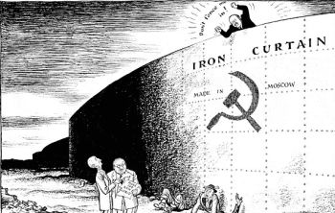
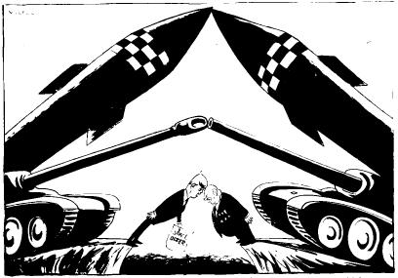
Bell Ringer
What do these cartoons represent?
What do they have to say about Cold War feelings between the US and Russia?

Slide 3
Outline – Cold War SSUSH 20-21
SSUSH20 The student will analyze the domestic and international impact of the Cold War on the United States.
Marshall Plan, Containment, & Truman Doctrine
Communist Revolution in China, Korean War, & Joseph McCarthy
Cuban Revolution, Bay of Pigs, Cuban Missile Crisis
Vietnam War, Tet Offensive, Opposition to War
Changing Geography Due to Cold War Policies

Slide 4
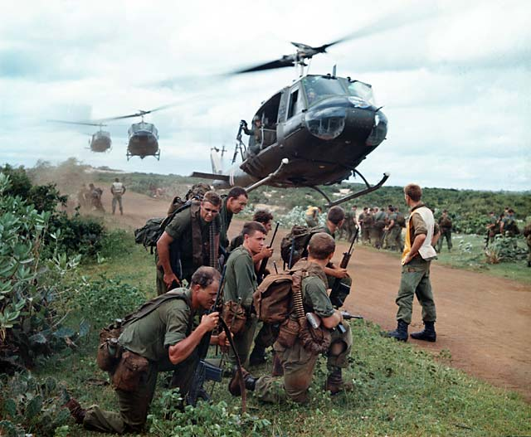
SSUSH20 The student will analyze the domestic and international impact of the Cold War on the United States

Slide 5
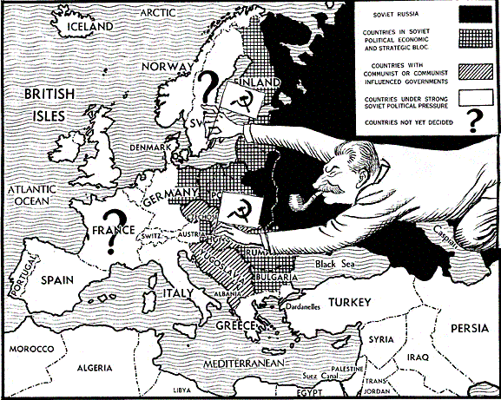
DO NOW
Examine the political cartoon.
Who is this man?
What is he doing?
What does this map represent?
Name this cartoon – explain your choice.

Slide 6
The Cold War
The Cold War was the era of confrontation and competition beginning immediately after WW II between the United States and the Soviet Union

Slide 7
a. Describe the creation of the Marshall Plan, U.S. commitment to Europe, the Truman Doctrine, and the origins and implications of the containment policy
After WW II much of Europe was devastated physically and economically
To rebuild Europe and support democratic ideas, the U.S. developed the Marshall Plan which provided billions of dollars in aid to European countries
The Soviet Union rejected the aid and developed it’s own economic program

Slide 8
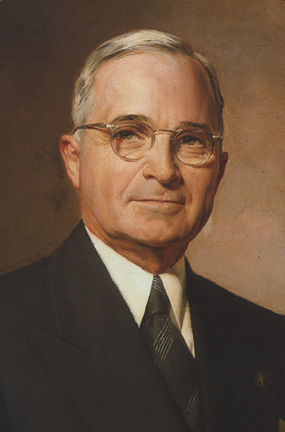
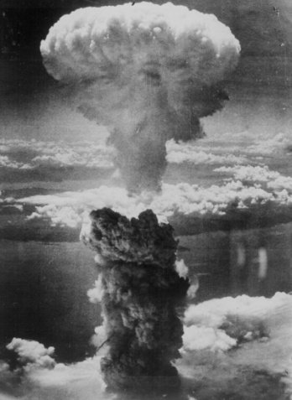
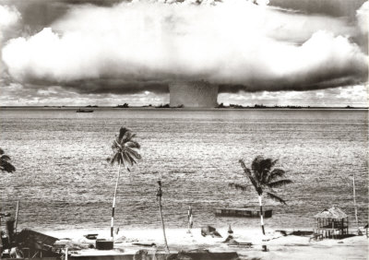
Truman Doctrine
Proposed by President Harry Truman in 1947, The Truman Doctrine provided aid to any country battling Communist aggression
It was immediately used to support the free governments in Turkey and Greece against communist threats

Slide 9
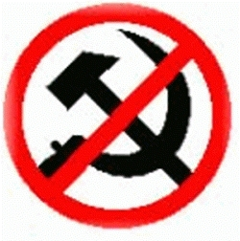
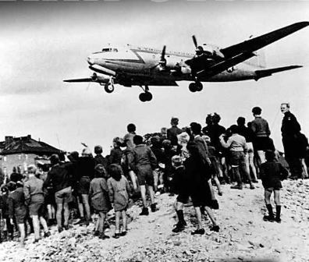
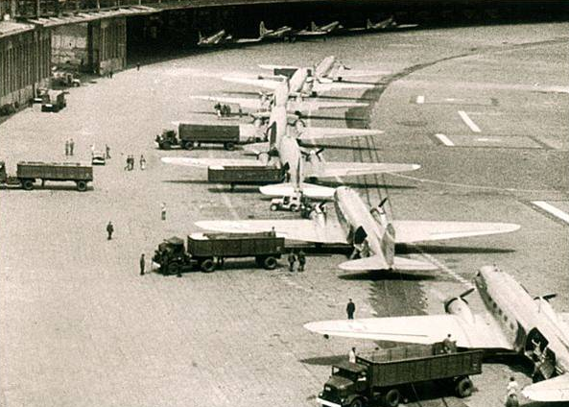
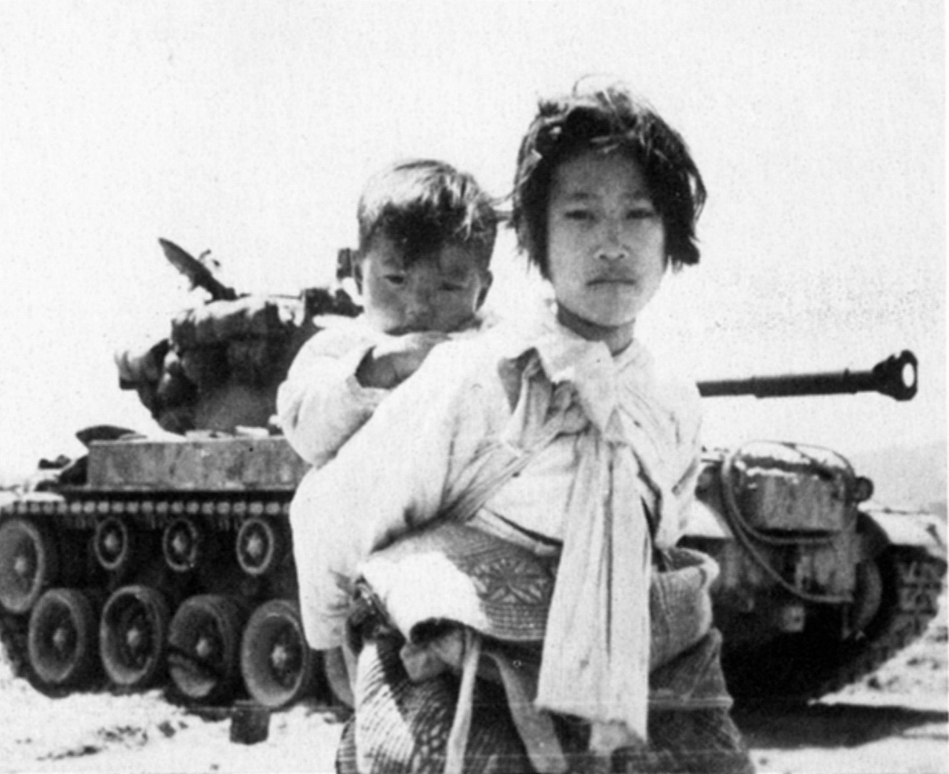
Containment Policy
Containment
The U.S. policy towards the Soviet Union and communism
Used to block, or contain, communist expansion into other countries

Slide 10
Compare Containment, the Marshall Plan and the Truman Doctrine.

Slide 11
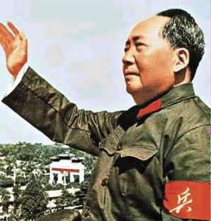
b. Explain the impact of the new communist regime in China and the outbreak of the Korean War and how these events contributed to the rise of Senator Joseph McCarthy
Following WW II, China was involved in a civil war between the U.S. backed Nationalist government and Mao Zedong’s Communist forces
Despite help from the U.S. the Nationalist government lost and retreated to the island of Taiwan
The Communist People’s Republic of China was formed in 1949

Slide 12
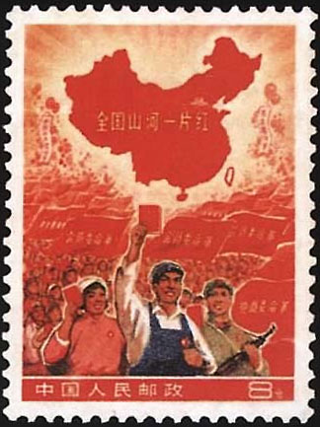
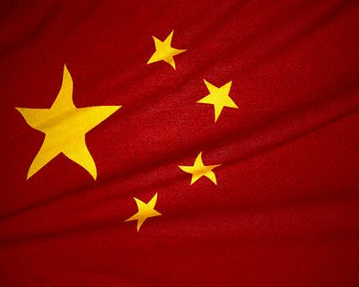
Communist Revolution
In 1950, the People’s Republic and the Soviet Union signed a treaty of alliance
The U.S. feared that the two countries would spread communism across the globe
The U.S. immediately began to industrialize/rebuild Japan in order to gain an ally in Asia

Slide 13
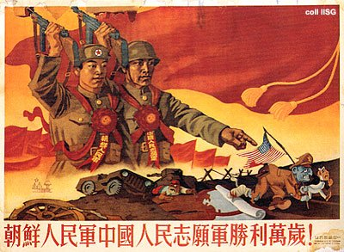
Korean War
At the end of WW II Korea was split into two at the 38th parallel, with the Soviets occupying the north and the U.S. occupying the south
Both the North and the South formed their own governments and claimed the entire country as their own.
In 1950 the Soviet backed North Korean Army invaded South Korea nearly capturing the whole country

Slide 14
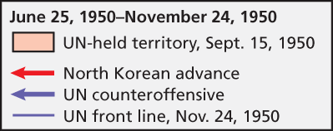
Korean War
The U.S. Army backed by United Nations troops, counter-attacked and pushed the North Korean Army to the border of China
Feeling threatened by the advance, China attacked and forced the U.S. to retreat back behind the 38th parallel

Slide 15
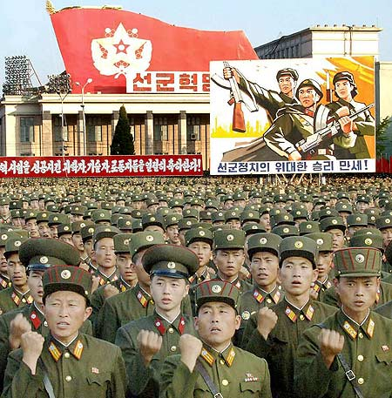
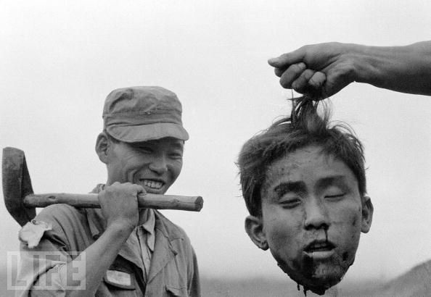
Korean War
The two sides eventually signed a peace treaty in 1953
The U.S. then began to build up their military and signed defense agreements with many Asian countries
The U.S. also began sending aid to French forces fighting Communist forces in Vietnam

Slide 16
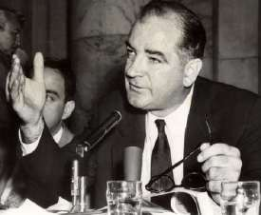
Senator Joseph McCarthy
The rise of Communism in the Soviet Union and China, and the war in Korea gave rise to a new Red Scare in the U.S.
Many Americans felt as though the U.S. was losing the Cold War battle and wanted a government explanation
In 1950 Senator McCarthy claimed to have a list of 205 men working for the U.S. government who were members of the Communist Party-this claim propelled him into the American spotlight

Slide 17
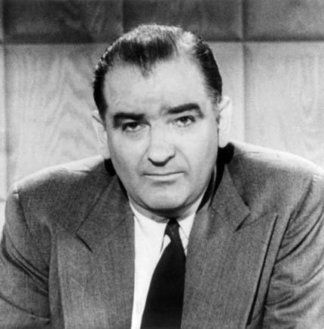
McCarthy
In 1952 McCarthy began holding hearings about Communism, accusing many in the government of being spies, or Communist sympathizers
His “witch-hunt” for communist became know as McCarthyism. Those who openly challenged McCarthy would be accused of being a communist sympathizer

Slide 18
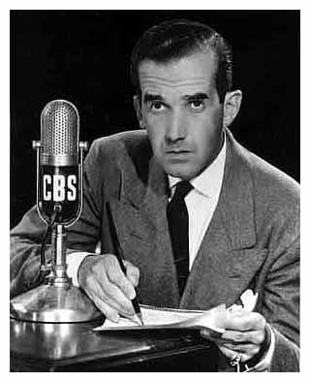
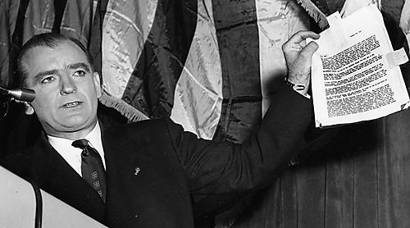
McCarthy-ism
McCarthy’s downfall began in 1954 when, in televised hearings, he accused the U.S. Army of containing communists
As millions of Americans watched on TV, he openly badgered and harassed witnesses
With pressure from the American people, Congress censured McCarthy, ending his political power

Slide 19
c. The Cuban Revolution, the Bay of Pigs, and the Cuban missile crisis.
In 1959 Fidel Castro overthrew the American supported leader of Cuba, Batista.
Cuba, only 90 miles from the U.S. mainland, took control of all U.S. property in Cuba, including land and factories
The new Cuban leader, Fidel Castro, aligned his government with the Soviet Union

Slide 20
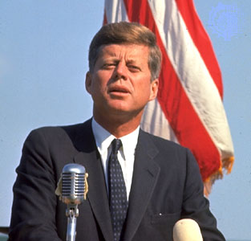
Bay of Pigs
When John Kennedy became President in 1961, he inherited a plan from the previous President which called for a CIA backed invasion of Cuba in order to over- throw Castro

Slide 21
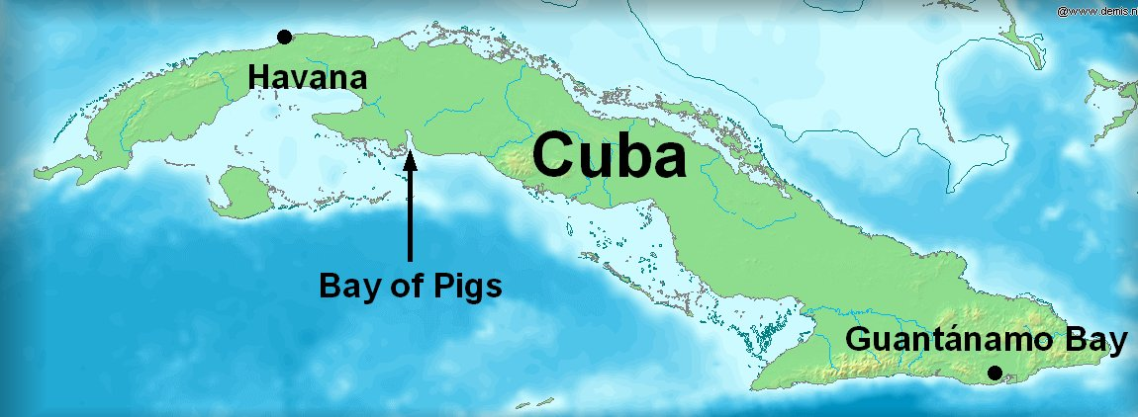
The U.S. worried that the Soviet Union would use Cuba as a base to spread Communism through out the Western Hemisphere
Though only the President for three months, Kennedy listened to his advisors and approved the secret plan which called for 1,500 Cuban exiles to attack, supported by U.S. planes

Slide 22
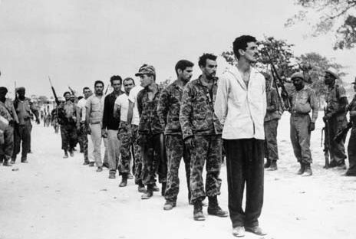
The attack was a disaster:
News of the attack leaked out days before it happened
The attack site, the “Bay of Pigs”, was poorly chosen with coral reefs slowing down the landing craft, and swampy land causing problems once ashore
In an effort to hide U.S. involvement, Kennedy refused to send in the expected air support
Within days Cuba had captured or killed the invaders

Slide 23
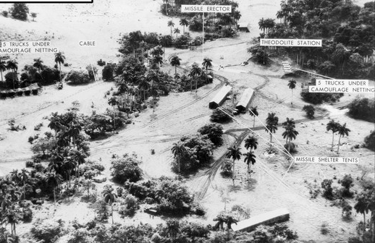
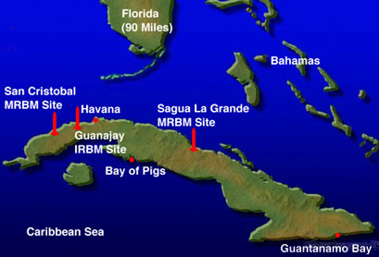
Cuban Missile Crisis
In 1962 U.S. spy planes photographed Soviet made long range missiles being set-up in Cuba
Russia will take missiles out as long as U.S. does not invade

Slide 24
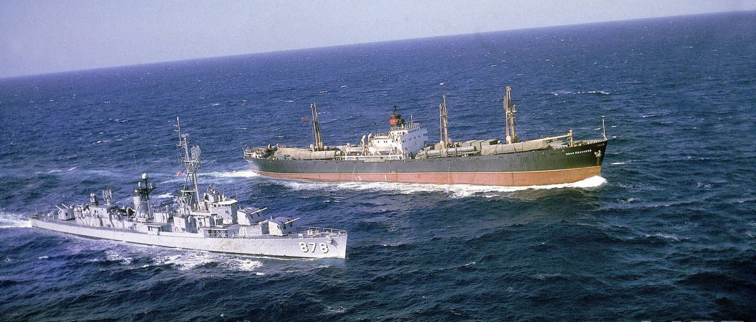
Cuban Missile Crisis
Kennedy ordered a naval blockade of Cuba, demanded that the Soviets dismantle and remove the missiles, and warned Russia that the U.S. would launch an all out nuclear missile attack on the Soviet Union if any missiles were fired from Cuba

Slide 25
Cuban Missile Crisis
The Soviets ignored the warning and continued to work on the sites
Many in the U.S. believed that a nuclear holocaust would occur
In late October, after secretly negotiating with the Soviets, disaster was avoided
Russia agreed to pull out of Cuba if the U.S. promised not to invade the island

Slide 26
SSUSH21d. Describe the impact of competition with the USSR as evidenced by the launch of Sputnik I and President Eisenhower's actions.
Sputnik 1 – the first artificial Earth satellite to be launched into outer space by the USSR on October 4, 1957.
This was the first in a series of satellites collectively known as the Sputnik Program.

Slide 27
SSUSH21d. Describe the impact of competition with the USSR as evidenced by the launch of Sputnik I and President Eisenhower's actions.
The Union of Soviet Socialist Republics (USSR) reached outer space before the US and because of the competition between Americans and Russians the United States Space Program was launched.
Although President Eisenhower tried to “downplay the satellite as a ‘useless hunk of iron,” he became anxious about keeping America ahead of all Soviet achievements.
This created an urgency to initiate a space program to get American satellites in the air.

Slide 28
d. Describe the Vietnam War, the Tet Offensive, and growing opposition to the war.
The U.S. had been sending economic and military aid to South Vietnam since the early 1950s to combat North Vietnam’s Communist government
By 1963, the U.S. had over 16,000 “advisers” in South Vietnam

Slide 29
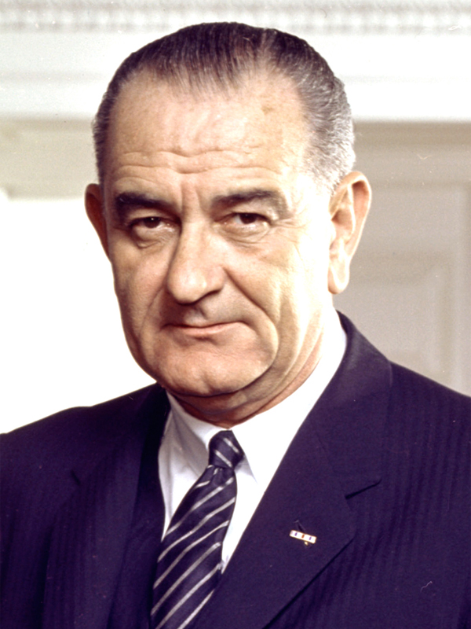
Vietnam War
In August 1964 President Lyndon Johnson announced that North Vietnamese ships had attacked two American destroyers (this turned out to be untrue)
Johnson asked permission from Congress to let American forces defend themselves if attacked: Congress approved the Gulf of Tonkin Resolution

Slide 30
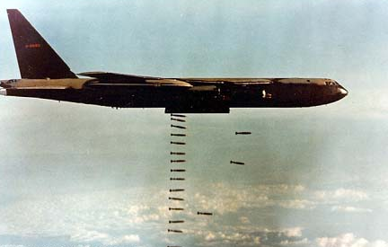
Vietnam War
The Vietcong began attacking military bases in the South, which killed and wounded U.S. advisers
In 1965 Johnson ordered U.S. jets to attack positions in the North
In March 1965, Johnson launched Operation Rolling Thunder, a bombing
campaign of the North,
and sent more than
180,000 troops to
fight in Vietnam

Slide 31
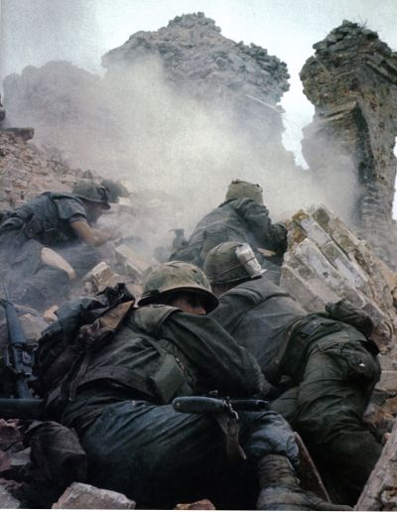
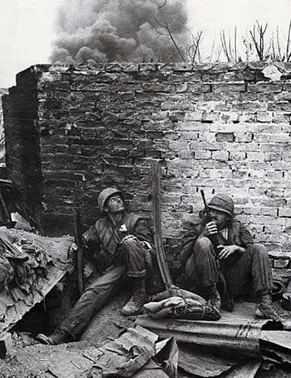
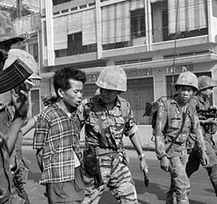
Tet Offensive (1968)
In early 1968, military leaders announced that U.S. forces were gaining strength and winning the war
In late January 1968, the North Vietnamese launched a surprise attack during the Vietnamese New Year. They attacked nearly every U.S. airbase and most major cities in the South

Slide 32
Assassination of Viet Cong

Slide 33
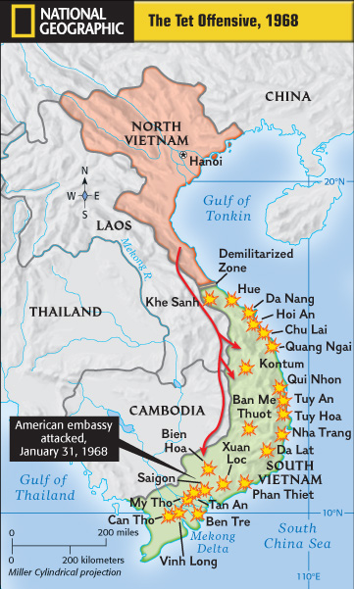
Though the attack was a military failure, the Tet Offensive was a turning point in the war because most Americans came to believe that the U.S. could not win the war
President Johnson’s approval rating dropped dramatically and eventually led Johnson not to seek reelection

Slide 34
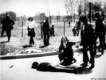
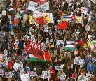
SSUSH24c. Analyze the anti-Vietnam War movement.
Americans against the war in Vietnam became more vocal in their opposition.
Many anti-war groups started on college campuses to urge the govt. to end the selective service (draft) and bring all American troops home from Vietnam.
They used sit-ins, marches, and demonstrations.
Later some protesters became more radical, burning their draft cards, going to prison, or fleeing to Canada

