Slide 1
SSUSH24 The impact of social change movements and organizations of the 1960s

Slide 2
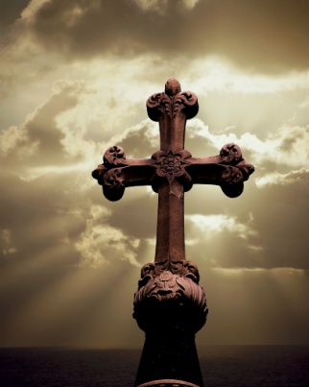
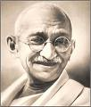
a. Compare and contrast the Student Non-Violent Coordinating Committee (SNCC) and the Southern Christian Leadership Conference (SCLC) tactics; include sit-ins, freedom rides, and changing composition
SCLC
Founded by MLK - preached non violence.
He based his ideas on the teaching of Jesus, Gandhi, Henry David Thoreau, & A. Philip Randolph.
MLK joined with other ministers and civil rights leaders in1957.
Together they formed the Southern Christian Leadership Conference (SCLC).

Slide 3
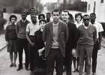
SNCC
By 1960, another influential civil rights group emerged.
The Student Nonviolent Coordinating Committee (SNCC), (“snick”) was formed mostly by college students.
Members of this group felt that change for African Americans was occurring too slowly.
SNCC Headquarters

Slide 4
One protest strategy that SNCC (“snick”) used was the sit-in.
During a sit-in, blacks sat at white only lunch counters.
They refused to leave until they were served.
In North Carolina, during a sit in, students sat as whites hit them and poured food all over their heads.
By late 1960 they had desegregated lunch counters in 48 cities in 11 states.

Slide 5
DO NOW:
Review the bolded lines of your Guided Notes in preparation for 5-Step Protocol
Underline any words or phrases you need defined.

Slide 6
 | SCLC | SNCC
Founding | MLK, Jr., and other ministers and Civil Rights leaders | African American college students with $800 received from the SCLC
Goal | Nonviolent crusades against the evils of second-class citizenship | To speed up changes mandated by Brown v. Board of Education
Original Tactics | Marches & protests in South, using churches as bases | Sit-ins- at segregated; registering Afr. Am. to vote, hoping to influence Congress to pass voting rights act
Later Tactics | Registering African Americans to vote, in hope they could influence Congress to pass voting rights act | Freedom Rides to determine if southern states would enforce laws against segregation in pub. trans.
Original Membership | Average African American adults; white adults | African American & white college students
Later Membership | Same as original membership | African Americans only; no whites
Original Philosophy | Nonviolence | Nonviolence
Later Philosophy | Same as original philosophy | Militancy and violence; “Black Power” and African-American pride

Slide 7
DO NOW
Get out your video guide (completed).
Get out your SSUSH 21-25 Graphic Organizers and be prepared for notes.

Slide 8
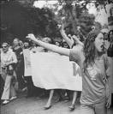
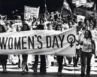
b. Describe the National Organization of Women and the origins and goals of the modern women’s movement.
The National Organization of Women (NOW) was founded in 1966 to promote equal rights and opportunities for American women.
NOW had its origins in the Civil Rights & anti war Movements of the early 1960s.
NOW’s goals included equality in employment, political and social equality, and the passage of the Equal Rights Amendment.

Slide 9
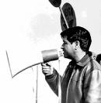
d. Analyze Cesar Chavez and the United Farm Workers’ movement.
Latinos also protest to gain civil rights in the 1960s.
Their leader was César Chávez, a Mexican-American, from California.
Chávez believed in nonviolent methods to achieve his goals.
He started a nationwide boycott of California grapes, forcing growers to negotiate a contract with the United Farm Workers in 1970.
This contract gave workers higher wages and
other benefits .

Slide 10
e. Explain the importance of Rachel Carson’s Silent Spring and the resulting developments; include Earth Day, the creation of the Environmental Protection Agency (EPA), and the modern environmentalist movement.
Silent Spring, a 1962 book about pesticides by Rachel Carson, exposed dangers to the environment.
This book led to the Water Quality Act of 1965
The first Earth Day was celebrated in 1970, this raised awareness of environmental issues.
1970, Pres. Nixon created the Environmental Protection Agency (EPA) to set limits on pollution.

Slide 11
f. Describe the rise of the conservative movement as seen in the presidential candidacy of Barry Goldwater (1964) and the election of Richard M. Nixon (1968).
In 1964, the Republicans nominated Sen. Barry Goldwater for president.
He believed that the federal government should not try to fix social and economic problems such as:
poverty
discrimination
lack of opportunity
He did not win.

Slide 12
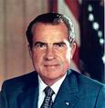
Richard Nixon
The conservative movement continued with the candidacy and election of Republican Richard Nixon in 1968.
Nixon wanted to replace President Johnson’s Great Society programs with what Nixon called New federalism.
This initiative would take away some federal government powers, such welfare and give them to the state and local government.

Slide 13
W2W
Write a 1-page response using ALL of the movements mentioned in class (underline each one you mention)
What were the social movements of the 1960’s? What were their goals? Who were their leaders? Which one was most important in your opinion?

Slide 14
EOC Quiz Questions
1 Who wrote “Silent Spring?”
2 What are three effects or facets of the modern environmentalist movement?
3 What organization worked for the rights of Latino laborers?
4 Who was the leader of the United Farm Workers?
5 What were the tactics for reform for SNCC and SCLC? Name at least one each.
6 Explain the controversy Richard Nixon faced.
7 How is Cesar Chavez similar to MLK?
8 Where did the Women’s Rights Movement originate?
9. This decision legalized abortion in the first trimester
10 This decision allows colleges to consider race in admissions.

Slide 15
DO NOW
QUIZ!!! GET OUT A SHEET OF PAPER and LABEL WITH:
Name, Date (4/28/15), EOC REVIEW QUIZ
YES This IS A GRADE
STUDY Environmental movement, SNCC, SCLC, Cesar Chavez, United Farm Workers, Anti-Vietnam War Movement and NOW

Slide 16
DO NOW
Get out your SSUSH 25 Graphic Organizer
Sit QUIETLY and wait for further instruction.

